Slide 1
Log Aggregation, Analysis and Diagnostics Platform
Team 1: Emmanuel Dairo, Ahmed Ikram, Sarah Kelly, Sam Watts, Martin Kelly, Addie Tweed, David Hyacinth-Ngwu

Slide 2
Problem
Need to…
Ingest different log sources across a network for ATMs into a homogenized form and aggregate them
Assess logs for defined anomalies
Analyse anomalies for patterns and correlations across different sources
Visualise this information

Slide 3
Approach
Defined personas, user stories and requirements before allocating any development work.
This helped us have a shared understanding of how we wanted the system to work.
We then followed an agile approach, holding daily standups to keep track of progress.
For our tech stack, we went with Python for the backend, interacting with our React frontend via FastAPI. We also used SQLite for our database.

Slide 4
Team roles
Emmanuel - Leader / analysis
Ahmed - Log Ingestion / backend
Martin - Anomaly Detection / backend
Addie - Analysis / backend
Sarah - Menus / frontend
David - Details Page / frontend
Sam - Frontend / scrum master

Slide 5
Ingestion
Prometheus and GCP in CSV
Kafka and app logs in JSON streams
OS and hardware sensor metrics.
Entrypoint for the rest of the system. Pulls logs and metrics from different sources, normalises them into a consistent format and stores them inside an SQLite database for the anomaly detection frontend.
Each source has a dedicated parser, meaning new sources only require adding a new class.
All parsed data flows through a normalisation step.
Writes go out in batches through a ‘writehelper’ that handles SQLite lock contention with retry/backoff. Database runs in WAL mode for better concurrency.
PostgreSQL was considered, but given project scope; dealing with a few ATMs as opposed to hundreds of thousands, SQLite kept the stack simple, testable and self-contained.
Timestamps converted to UTC
Log levels standardised
Fields mapped into unified tables:
Events for discrete log entries
Metrics for time-series numeric data.
Anything that can’t be parsed cleanly gets routed to the table ingestion_errors, as opposed to causing a crash

Slide 6
Anomaly Detection
A1: Network timeout cascade
A2: Cash cassette depletion
A3: JVM memory leak
A4: Container restart loop
A5: High response time spike — threshold-based Kafka + ATM app correlation
A6: OS memory pressure
A7: Malformed/out-of-order Kafka events
Follows on from ingestion by reading in from the database and identifying when something is going wrong across the network. Each detector follows a checklist pattern, gathering signals from multiple sources and firing when all conditions from the spec are met. Detected anomalies are written to the anomalies table with severity, explanation, correlation ID and JSON evidence ready to be consumed by the analysis layer and frontend.

Slide 7
Analysis
Responsible for giving more detail on anomalous activity within the system. Assigns an explanation for cause, the potential operational impacts and the recommended fixes for each anomaly.
Utilises fields from logs related to the anomaly; related to correlation IDs, such as from related client or ATM. Description varies and in large part corresponds to the type of anomaly it is (cash depletion, network timeout etc).
A1 Fields Example:
# '{"network_disconnect": true, "error_code_correct": true, "timeout": true, "kafka_offline": true, "kafka_host_unavailable": true, "terminal_timeout": true, "last_ts": "2026-03-30T07:59:00+00:00"}
Orders analysis based on ranking of how critical they are.
Each analysis has its own function, so accounting for analysis of additional future anomaly types would only require adding a new function.
Numerous factors go into determining ranking:
Anomaly type (Cash depletion, network timeout etc) are weighted differently in terms of how detrimental they are at a surface level. 'A1': 7, 'A4': 6, 'A3': 5, 'A2': 4, 'A6': 3, 'A5': 2, 'A7': 1
Time; older anomalies given higher priority
Severity - "CRITICAL": 3, "HIGH": 2, "MAJOR":1, "WARNING": 0
Whether a transaction is in progress

Slide 8
Further Notable Backend
Data retention duration can be configured. REST endpoints let admins both configure how long data is kept (up to 365 days) and perform manual cleanup. APScheduler job that runs every hour.
Authorisation with JWT-based login with admin and user roles. all endpoints are properly guarded.
39 passing tests covering end-to-end: parsers, DB schema, concurrent writes, auth, analysis and all the main API endpoints

Slide 9
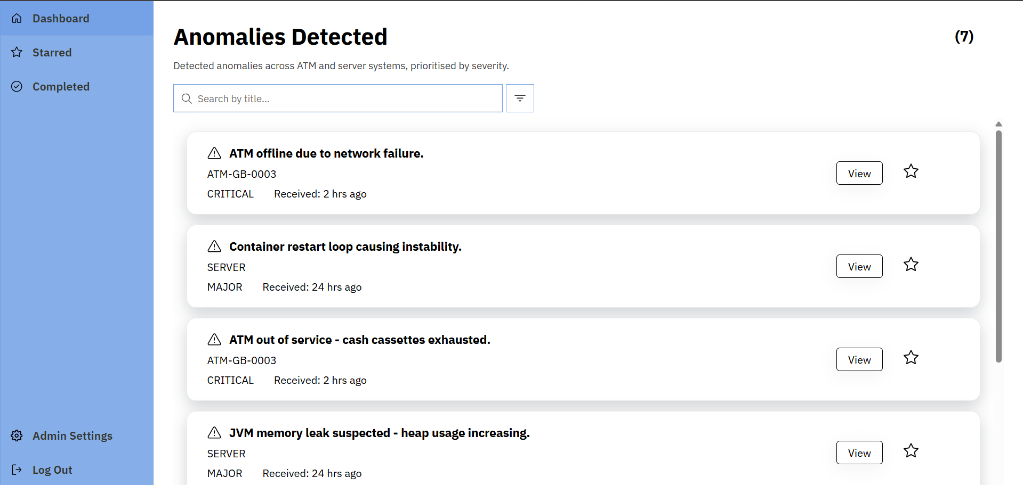
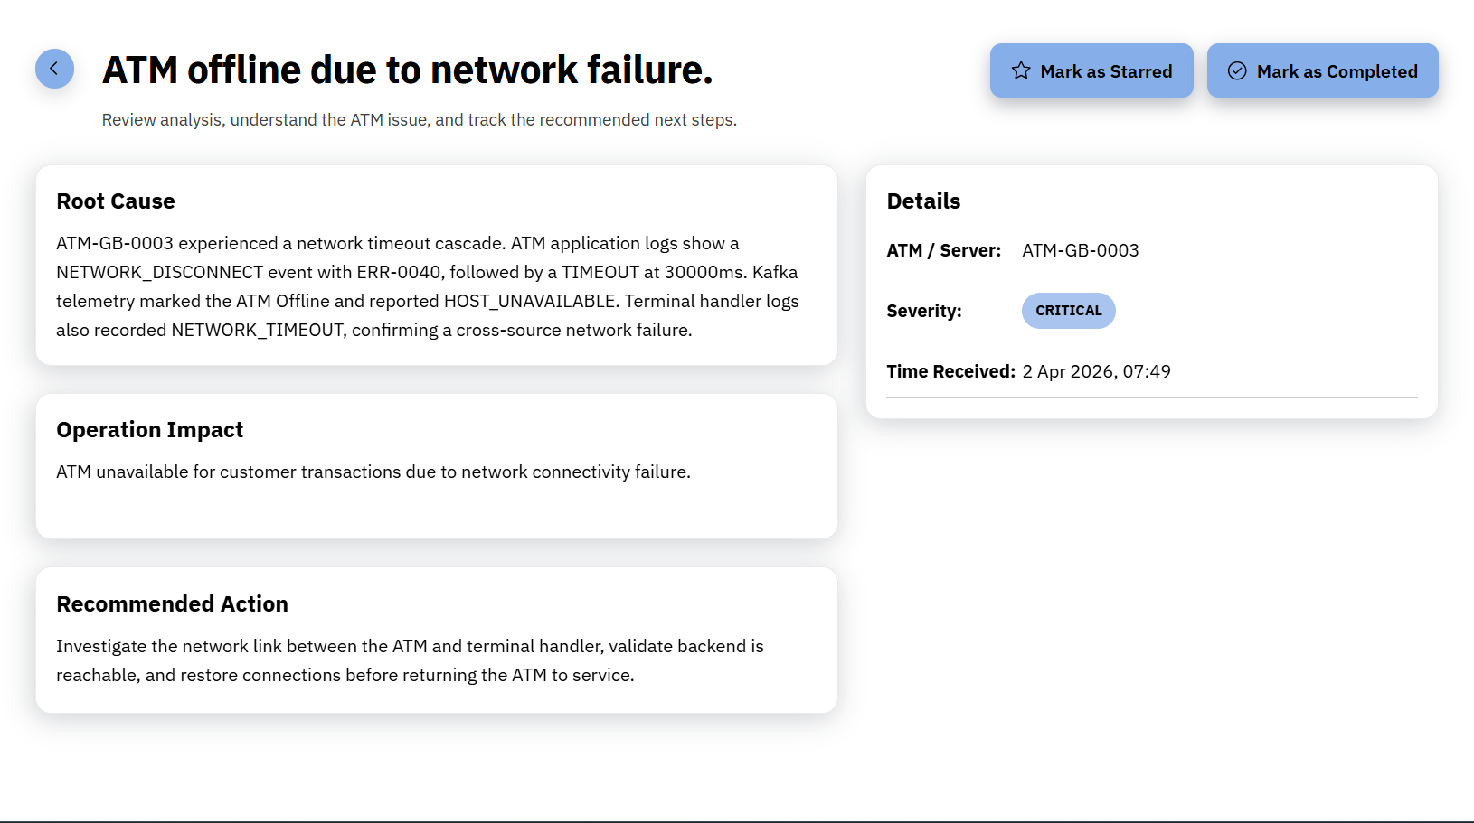
Display / Frontend
Due to our team’s limited experience with frontend technologies, we decided to keep the UI simple, showing only the most important information.
We decided on a list containing high-level information about anomalies detected.
We also provided a page for detailed information about anomalies, showing their root cause, operational impact and recommended action.

Slide 10
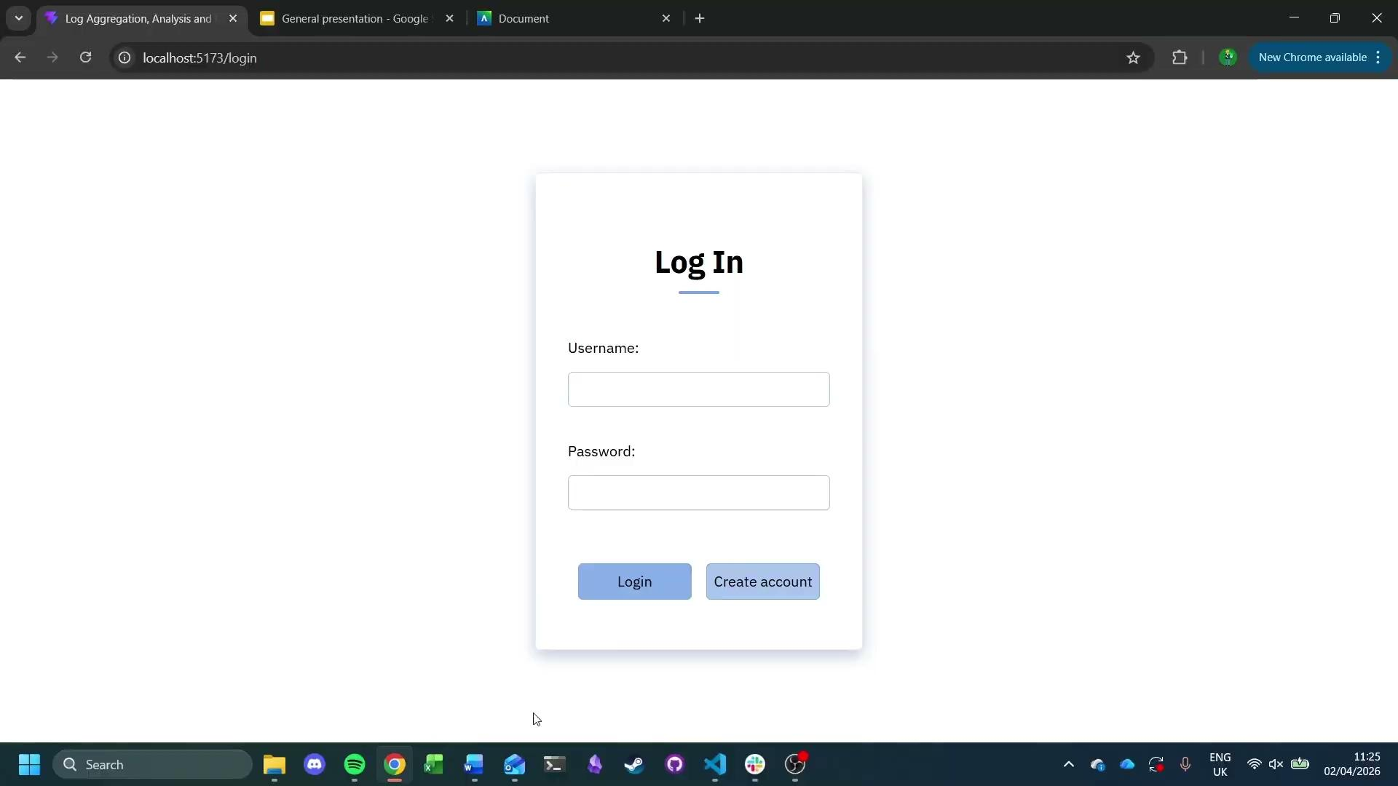
DEMO

Slide 11
Problems brought up by Evaluation
One user noted that the logo gave a false impression that it could be used as a home button. They also noted the lack of a back button.
None of the users noticed the anomaly filtering functionality.
One user noted that timestamps of anomalies should be involved in analysis ranking.
3 Undergraduates: 2 Computer Science and 1 Business
One participant acknowledged a lack of password policy. Most acknowledged the system would benefit from further security features like Multi-Factor Authentication or one time passwords.

Slide 12
Post-Evaluation
Implemented feedback:
Got rid of logo
Added back buttons
Addition of password policy (minimum 6 characters)
Moved anomaly filtering to be more noticeable
Added time-based ranking to analysis
Can remove an anomaly from “completed” status
Overall feedback was good. Usability and navigation beyond filtering and back buttons was well received. No confusion arose at anomaly or analysis information or the way it was presented.
One interesting note was one participant commenting on how they didn’t understand the information within the analysis, but understood that relevant engineers likely would, which falls well into our Manager user story.

Slide 13
Next Steps
Looking forward, there are a few features we would add:
One of these is making starring user-based, instead of global.
Another feature we would add would be to have predictive detection, using AI and pattern recognition to detect when anomalies could appear in the future.
A further feature would be to allow real-time log ingestion, detecting anomalies as soon as they occur.
We could also make the software less specific for ATMs, allowing any logging to be processed by the system.

Slide 14
Summary
We believe we’ve met all the requirements, implementing log ingestion, anomaly detection, analysis and a visual interface to display this information.
Furthermore, we implemented some additional features such as custom data retention length, anomaly display filtering, and admin and user permissions, and data access.

Slide 15
Thanks!

